Slide 1
3D-CHESS: Decentralized, Distributed, Dynamic, and Context-aware Heterogeneous Sensor Systems
Daniel Selva (PI, Texas A&M University)
George Allen (Co-I, Virginia Tech)
Huilin Gao (Co-I, Texas A&M University)
Ankur Mehta (Co-I, UCLA)
Yizhou Sun (Co-I, UCLA)
Cedric David (Co-I, JPL)
AIST-21-0089 Kick-Off Meeting
August 11, 2022

Slide 2
Presentation Contents
Financials
Quad Chart
Schedule
Team
Background and Objectives
Response to Review Panel Comments
TRL assessment
List of Acronyms

Slide 3
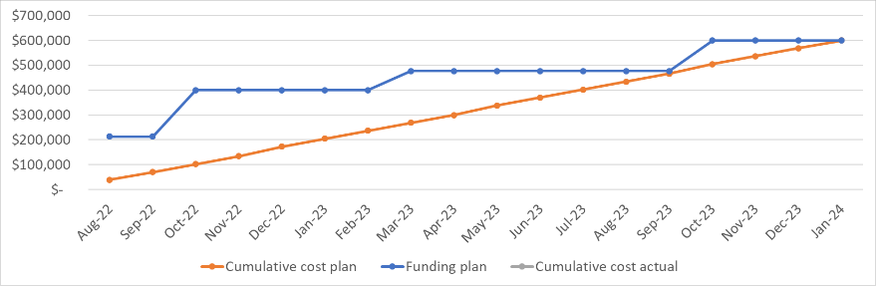
Costs Status and Plan
Working to input this into ERS
Delay in awards may lead to some issues with students. Working with Co-Is to ensure this is not going to be a problem
No costs incurred as of yet

Slide 4
Presentation Contents
Financials
Quad Chart
Schedule
Team
Background and Objectives
Response to Review Panel Comments
TRL assessment
List of Acronyms

Slide 5
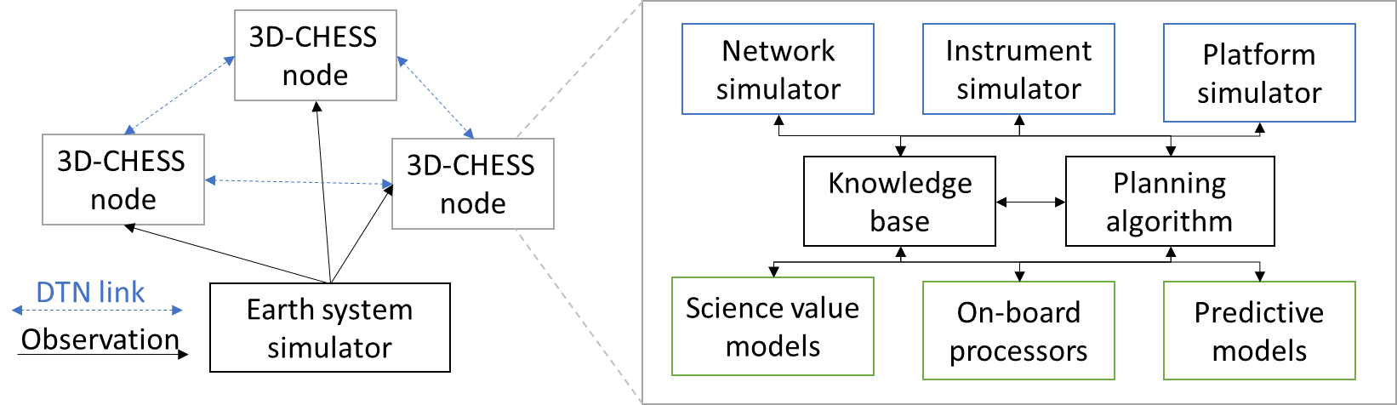
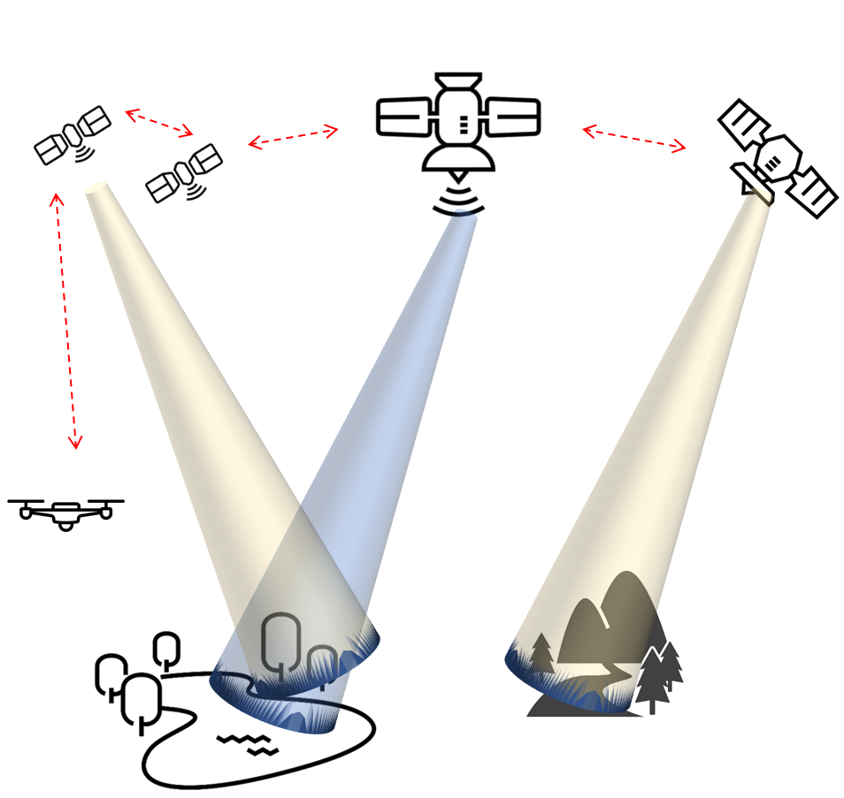


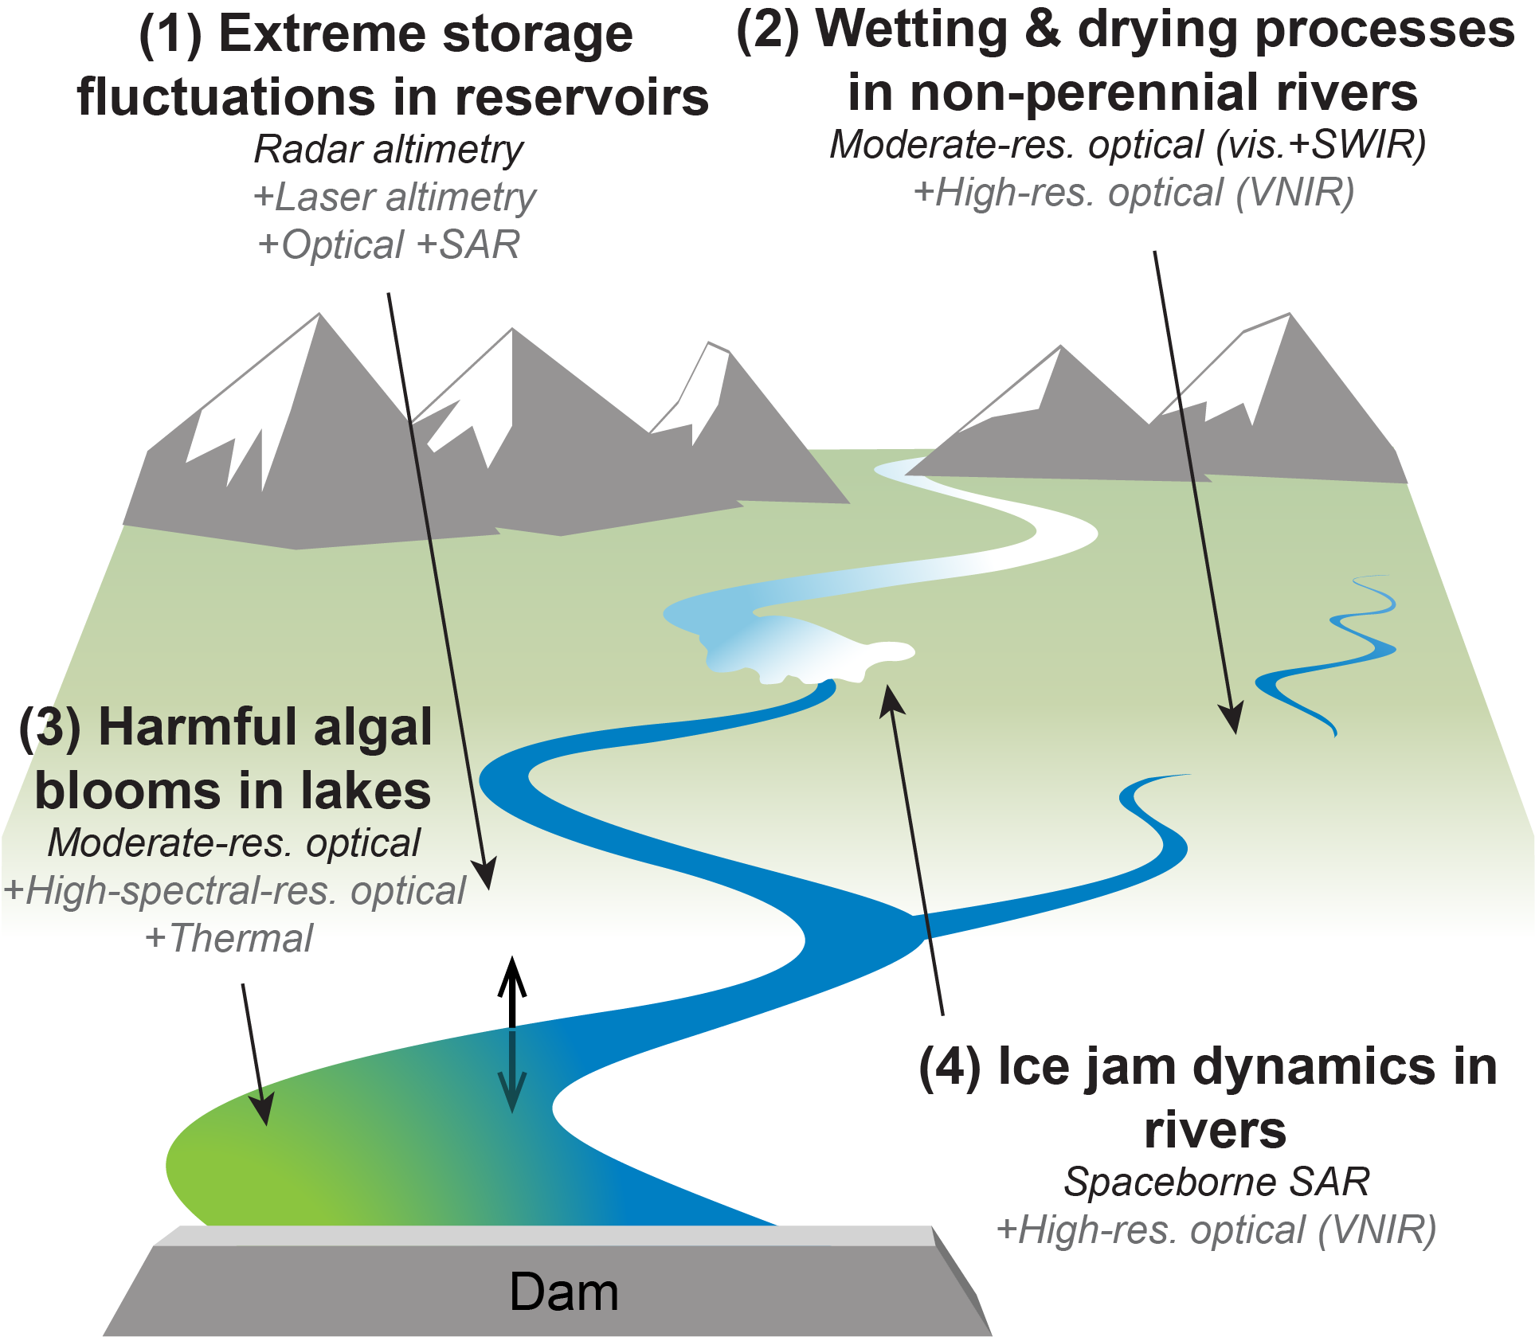
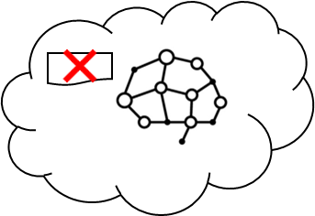
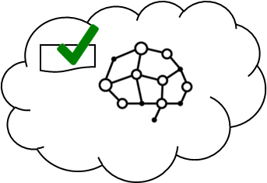
3D-CHESS: Decentralized, Distributed, Dynamic, and Context-aware HEterogeneous Sensor Systems
PI: Daniel Selva, Texas A&M University
Objective
Demonstrate proof of concept (TRL 3) for a context-aware Earth observing sensor web of interconnected space, air and ground nodes.
Context awareness: ability for the nodes to gather, exchange, and reason about contextual information (e.g., state of the observable, state and capabilities of itself and of other nodes in the network and how those relate to the task request and mission objectives).
Demonstrate the technology and assess the value of contextual information in a multi-sensor in-land hydrologic and ecologic monitoring system with four inter-dependent mission objectives: studying intermittent rivers and sediment transport, and monitoring floods and algal blooms
Approach
Key Milestones
Knowledge graph reasoning using UniKER algorithm allows nodes to determine if they can perform a task
Decentralized planning using modified CCBBA algorithm
Platform/Instrument/Network simulators using existing tools (PyOrbit, InstruPy, and dtnSim) provide realistic engineering constraints to planning algorithms
Simple science models provide reasonable science-driven estimates of scientific/societal value of observations to planning algorithms
Multi-agent simulation to benchmark 3D-CHESS against status quo and intermediate “transition” architectures
System architecture/interfaces defined 11/22
Initial Integration and verification complete 01/23
Performance in basic case characterized (TRL 2) 03/23
Value of technology characterized in basic case 09/23
Multi-mission use case demonstrated (TRL 3) 11/23
TRL_{in} = 1-2
TRL_{current} = 1-2
Co-Is/Partners: George Allen (VT); Huilin Gao (TAMU); Ankur Mehta, Yihzou Sun (UCLA); Vinay Ravindra (ARC); Cedric David (JPL).
11/21
AIST-21-0089

Slide 6
Project Schedule

Slide 7
Team Members: Senior Personnel
Team member | Role | Affiliation | Responsibilities
Daniel Selva | PI Space Systems | TAMU | Project management Lead definition of 3D-CHESS architecture, use cases, and validation strategies Coordinate overall scientific direction
George Allen | Co-I Earth Science | Virginia Tech | Lead inland water system application Lead development of science value models (ice jams and non-perennial river drying and wetting processes)
Huilin Gao | Co-I Earth Science | TAMU | Define 3D-CHESS relevance scenario mission Lead development of science value models (reservoir storage and lake algal blooms)
Cedric David | Co-I Earth Science | JPL | Coordinate use of RAPID model in 3D-CHESS Guide 3D-CHESS science application scenario
Ankur Mehta | Co-I Electrical Engineering | UCLA | Lead development of decentralized estimation and multi-agent coordination aspects
Yizhou Sun | Co-I Computer Science | UCLA | Lead development of the knowledge graph, knowledge extraction, and knowledge graph reasoning algorithms
Vinay Ravindra | Co-I Space Systems | NASA ARC | Develop interfaces between 3D-CHESS and EO-Sim Provide input into overall architecture and application to relevance scenario

Slide 8
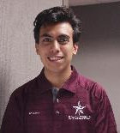
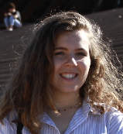
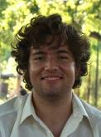

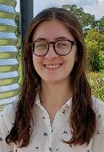

Team Members: Students and Post-Docs
Alan Aguilar Jaramillo, (Ph.D. student, Texas A&M University; Lead Developer).
Molly Stroud, (Ph.D. student, Virginia Tech; science algorithms and use case definition).
Ben Gorr, (Ph.D. student, Texas A&M University; Co-Lead Developer).
Kewei (Vivian) Cheng, (Ph.D. student, University of California Los Angeles; Knowledge base and reasoning algorithms).
Chrissi Erwin, (M.S. student, Texas A&M University; Planning algorithms).
Zida Wu, (Ph.D. student, University of California Los Angeles; multi-agent estimation and coordination algorithms).

Slide 9
Presentation Contents
Financials
Quad Chart
Schedule
Team
Background and Objectives
Response to Review Panel Comments
TRL assessment
List of Acronyms

Slide 10
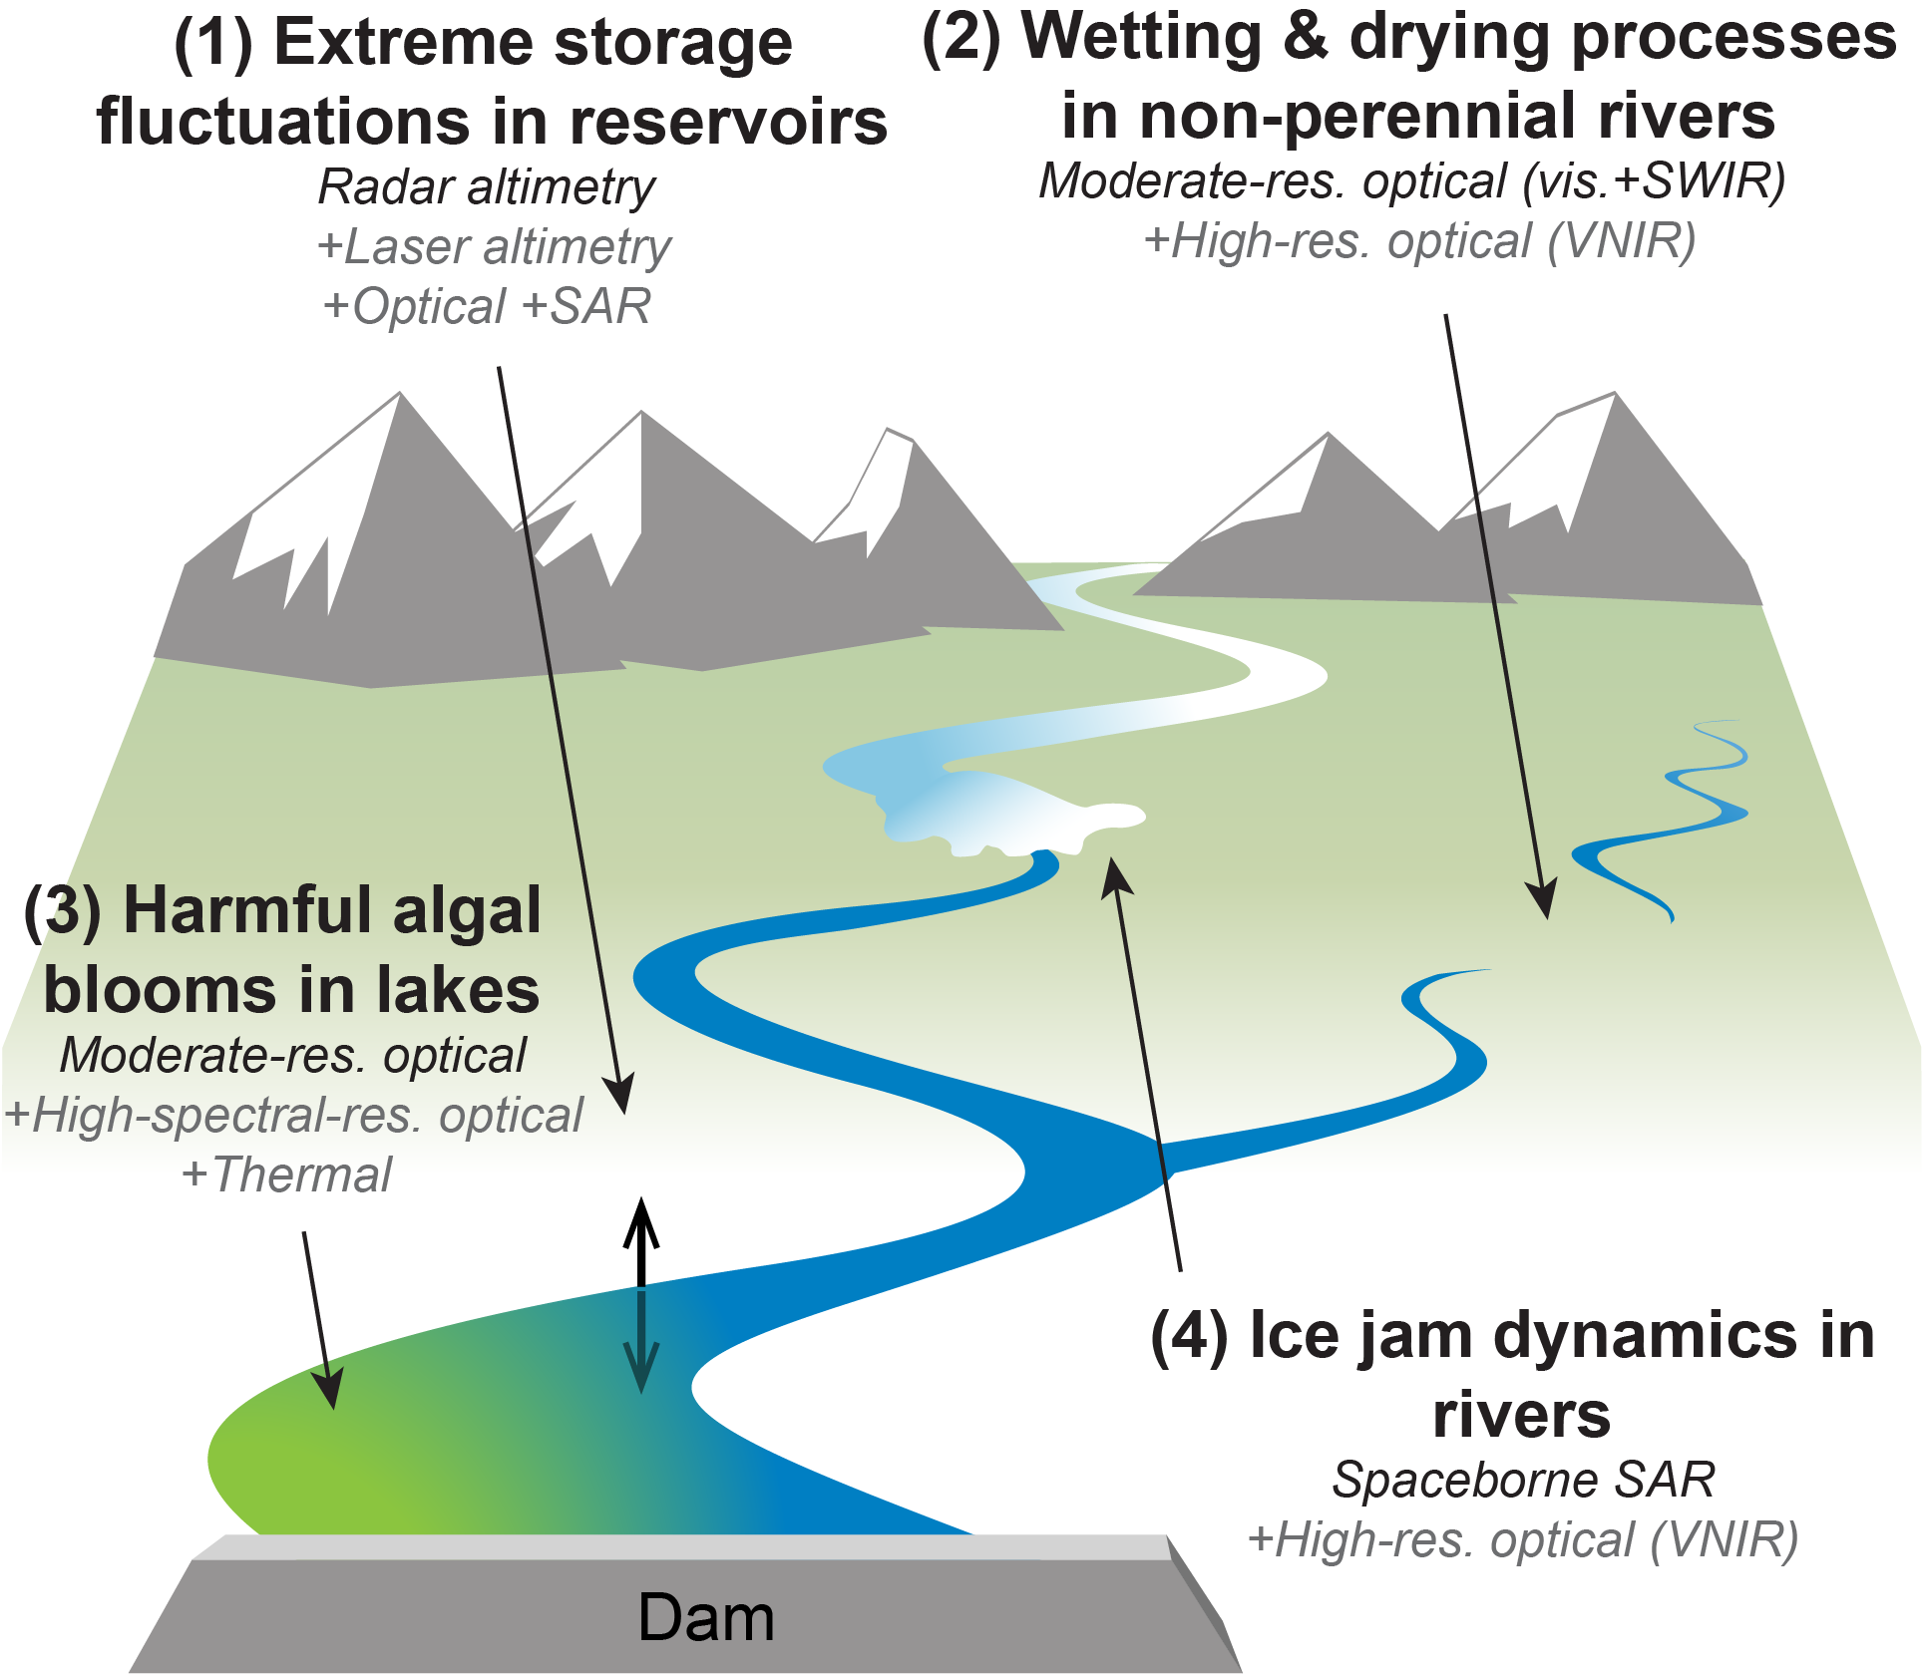
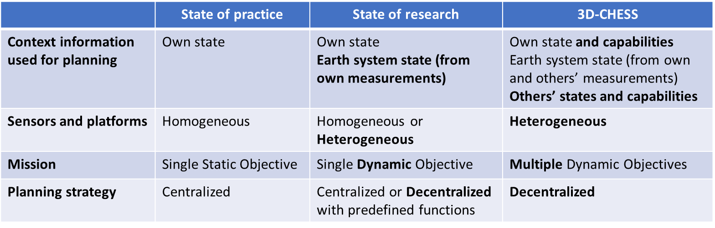
Background/Objectives
Overarching Goal: To provide proof of concept (TRL 3) for a context-aware network of heterogeneous sensors, in the context of an inland water ecosystem monitoring mission
Inland water bodies can dramatically change states within minutes to hours.
These changes are increasingly extreme and difficult to predict due to climate change .
Need for high spatial, temporal, and/or spectral resolutions, from heterogeneous sensors.
To monitor and respond to a dynamic environment, significantly more autonomy is needed in the Earth observing systems.
Autonomy requires context awareness and decentralized coordination.
Relevant to Objective O1: Enable new observation measurements and new observing systems design and operations through intelligent, timely, dynamic, and coordinated distributed sensing."
Relevant missions: SWOT, NISAR, Delta-X, SMASH

Slide 11
Background / Objectives
Enabling technologies: Knowledge graphs reasoning algorithms (UniKER) and decentralized planning algorithms (MCCBBA).
Approach: Multi-agent simulation (simPy) where each node consists of
Engineering module (platform, sensors, and network simulators) using EOSim
Science module (science value models, on-board processors, predictive models)
Decision-making module (knowledge-based reasoning, planning)
Objectives: Use multi-agent simulator to assess feasibility, scalability and value of the 3D-CHESS concept vs various benchmarks in the context of the relevance scenario
Quantify the value of implementing 3D-CHESS compared to the status quo
Study “transition” architectures (somewhere btw. 3D-CHESS and status quo)
Study “federated” architectures (nodes owned & operated by different agencies)

Slide 12
3D-CHESS: Concept of operations
1 – Default missions; data processing
Each node in the system conducts its nominal mission, following a default plan (e.g., provide global coordinated observations of inland water quantity and quality.)
Nodes can be in space, air, or ground, and they can perform one or more functions (observation, data processing, communication)
Nodes with data processing capabilities process the data on board in real time and look for events of interest.

Slide 13
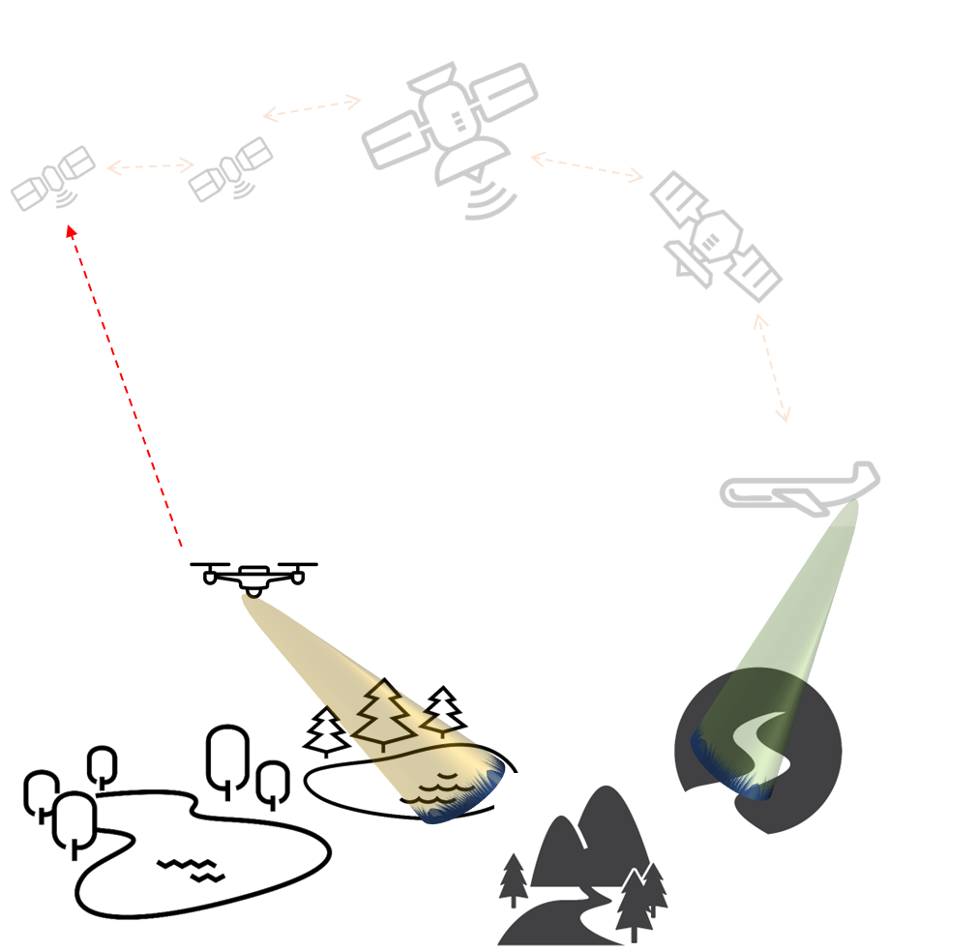


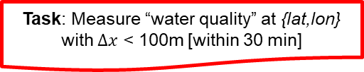
3D-CHESS: Concept of operations
2 – Event detected; task request sent
A node in the network detects (or predicts) an event of interest (e.g., a flood or a new intermittent river) at a certain location.
It sends a Task Request to the network.
Task: Measure “water quality” at {lat,lon} with $Δx$ < 100m [within 30 min]

Slide 14
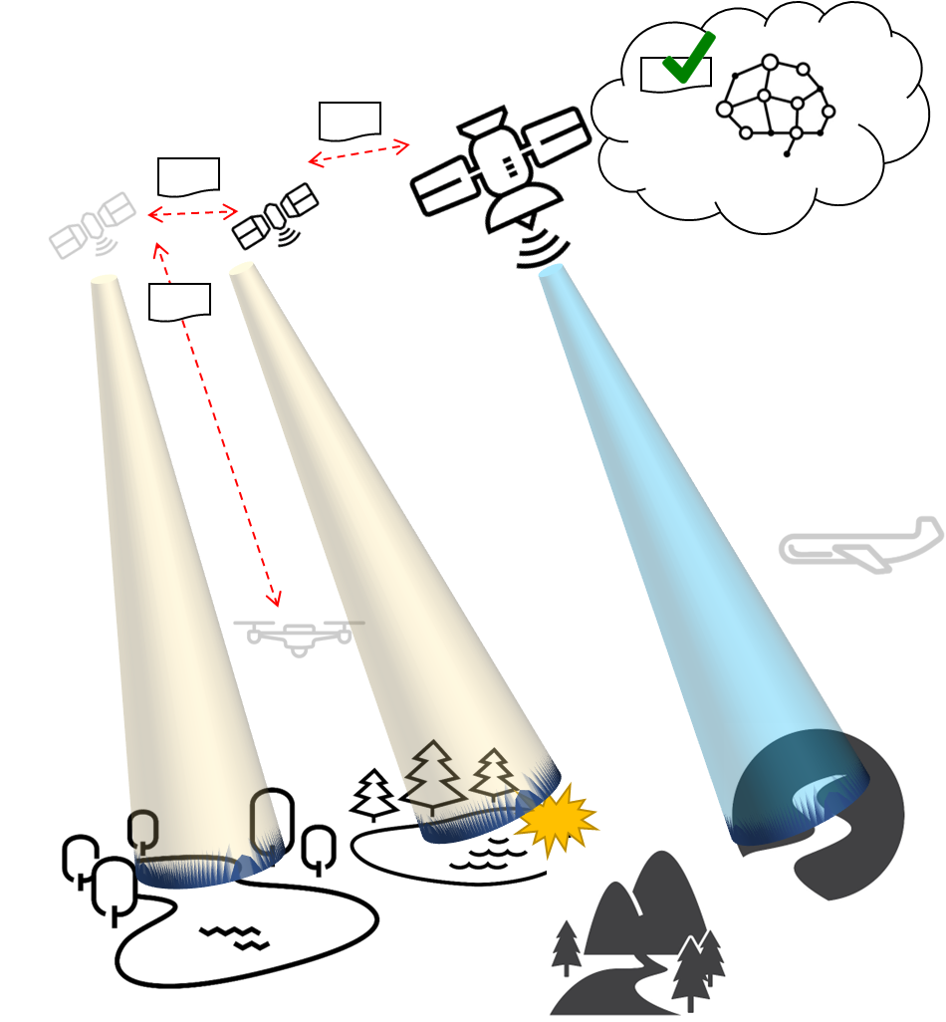
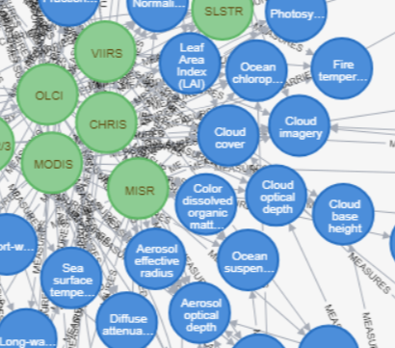
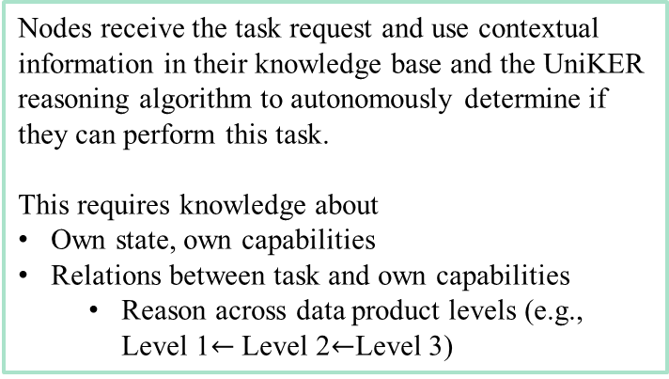
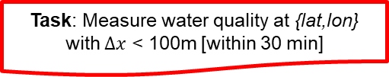
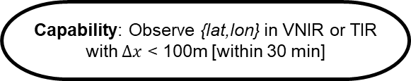
3D-CHESS: Concept of operations
3 – Instrument Capability Reasoning
Nodes receive the task request and use contextual information in their knowledge base and the UniKER reasoning algorithm to autonomously determine if they can perform this task.
This requires knowledge about
Own state, own capabilities
Relations between task and own capabilities
Reason across data product levels (e.g., Level 1$←$ Level 2$←$Level 3)
Capability: Observe {lat,lon} in VNIR or TIR with $Δx$ < 100m [within 30 min]
Task: Measure water quality at {lat,lon} with $Δx$ < 100m [within 30 min]
CanBeObtainedFrom(WaterQuality, Chlorophyll-A)
CanBeObtainedFrom(Chlorophyll-A, VNIR_Radiances)

Slide 15
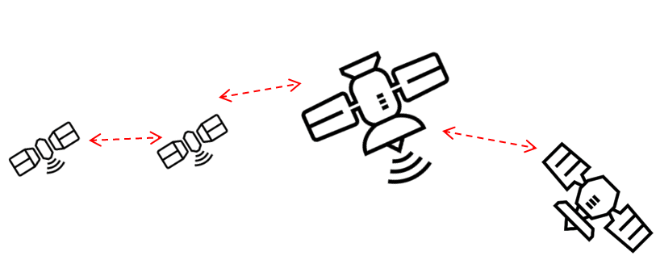
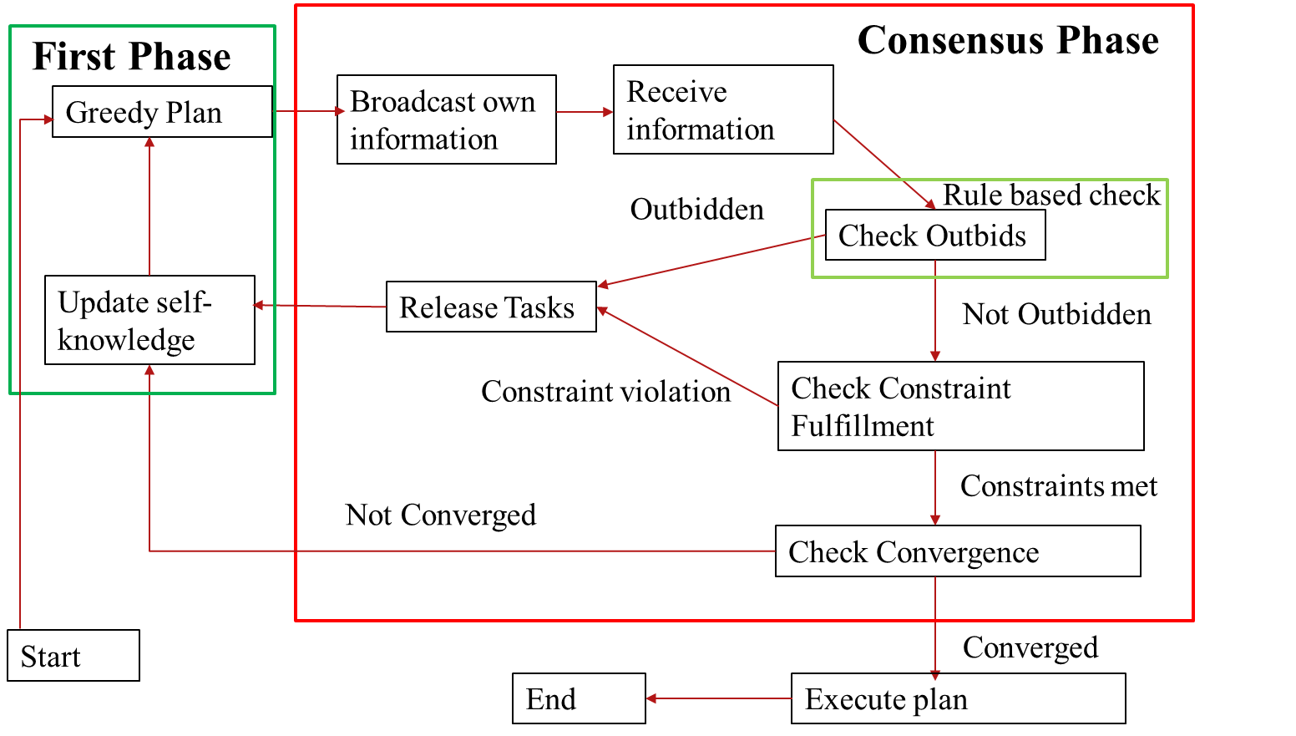
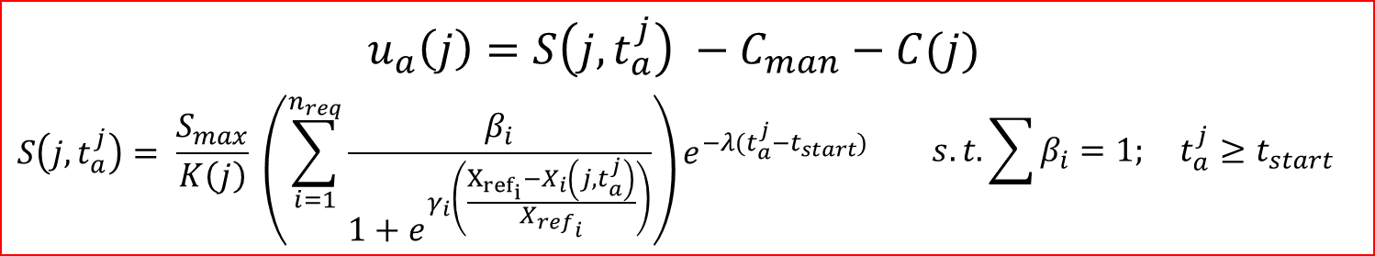
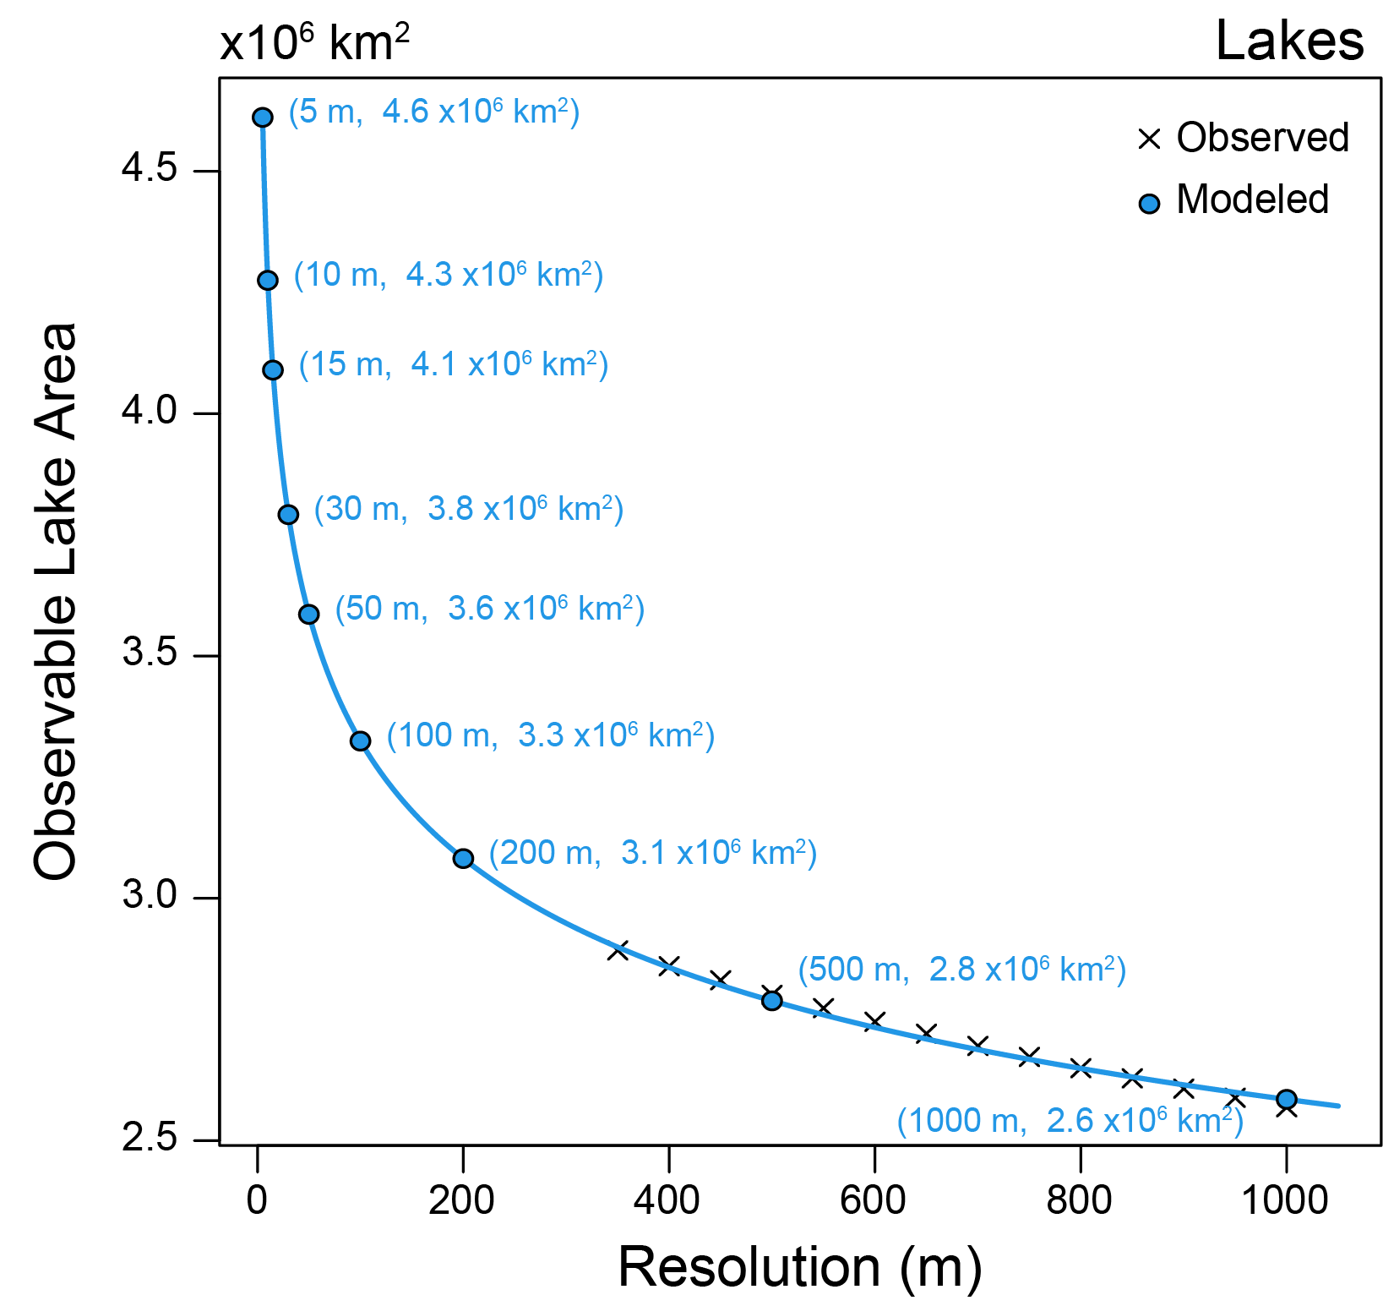
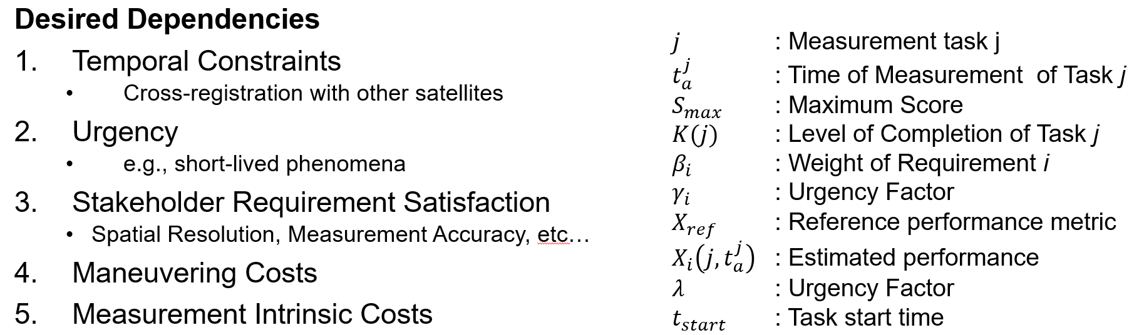
3D-CHESS: Concept of operations
4 – Decentralized planning
If they do, they enter a decentralized planning phase to coordinate who does what (MCCBBA algorithm).
Nodes use a science-driven utility function (using VASSAR) to determine if they should perform the task at the cost of temporarily abandoning their current mission. Engineering costs (energy, fuel) are also considered.
Once converged, the nodes update their plans

Slide 16
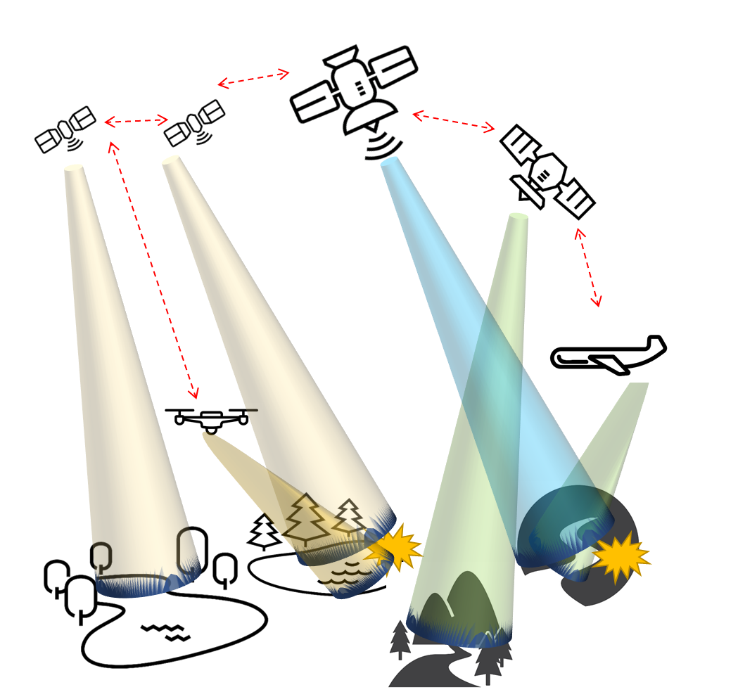
3D-CHESS: Concept of operations
5 – Updated plans; continue…
The network continues to operate in this way. Nodes are added or removed from the network over time. Node states and the Earth system state change over time.
Nodes capabilities and relations between capabilities and tasks may also change slowly over time (e.g., new science discoveries!)

Slide 17
Current State
3D-CHESS architecture definition has started internally at TAMU
Internal kick-off meeting next week with entire team
Focus next month is on project definition: architecture, use cases, validation
System architecture and interfaces between modules defined by end of Oct. (M1)
Initial integration and verification complete by end of CY (M2)

Slide 18
Presentation Contents
Financials
Quad Chart
Schedule
Team
Background and Objectives
Response to Review Panel Comments
TRL assessment
List of Acronyms

Slide 19
Responses to Review Panel Comments
Would this work in operational practice? Scalability?
Assessing feasibility and scalability in the context of the relevancy scenario using the multi-agent simulator is in the research plan (Task 8)
Effectiveness in comparison to conventional systems?
Assessing scientific value/effectiveness compared to status quo is part of the research plan (specific scenarios and metrics defined in Task 1.3)
What is required for a node to detect and communicate an event of interest at a certain location: will there need to be a calibration step considered? Consensus understanding of an event’s location? Geolocation and pointing accuracy often a limitation.
Decentralized estimation module has been added to research plan (Tasks 4.3-4.4) and will be led by Dr. Mehta at UCLA. Impact of limited pointing accuracy and geolocation will be measured in Task 8.
Federation analysis characterization is not well defined.
We will study federations of agents where different nodes are owned and operated by different organizations in Task 8.7. Specific scenarios and metrics will be defined in Task 1.3.
Notes:
http://www.wolframalpha.com/input/?i=days+since+10th+October+2011

Slide 20
Responses to Review Panel Comments
Depth of the simulators?
The modeling fidelity of the platform simulators is medium to low in an “absolute” sense, but we think it is adequate for the goals of the project. The architecture is flexible so higher fidelity simulators can be substituted.
Role of predictive models to drive the sensor modes and sampling?
The role of predictive models is to anticipate events of interest (e.g., floods, algal blooms) before they are detected by the on board processors. They can lead to changes in the agent’s own plans (e.g., change in sensor modes and sampling) and/or the emission of new Task Requests (e.g., to add complementary observations of the location).
How is increased fidelity of observations leveraged via data assimilation by those models? Role of improved observations for model validation or calibration should be discussed more.
Increased fidelity of observations would result in improved accuracy and a reduction of uncertainty in the outputs of the science module, which will also result in better plans.
Notes:
http://www.wolframalpha.com/input/?i=days+since+10th+October+2011

Slide 21
Responses to Review Panel Comments
There is a scale mismatch between what is required for the four applications and the models that are referenced.
The models referenced were provided as examples and we are aware that they are not sufficient to develop the 4 applications. We will adopt an incremental approach, starting with “Extreme storage fluctuations in reservoirs”, then adding “Harmful Algal blooms”, etc. Models will be identified or developed as needed for the applications. The team has broad and deep expertise in science models for inland water applications.
For some of the phenomena outlined there may be significant latency between precipitation events and their impacts to be observed.
Predictive models such as the RAPID flow routing model should help capture this latency and incorporate it into the agents’ plans.

Slide 22
Responses to Review Panel Comments
When occluding clouds are detected or subsurface information is needed, then what strategy is invoked?
The effects of cloudiness will be modeled in the Earth system simulator and accounted for in the planning algorithms. There is no way around sensors’ fundamental limits, but the 3D-CHESS network should be able to coordinate among themselves so that the best available sensor performs a given task.
Large team, small time commitments, ambitious objectives, requires a lot of coordination. Effort for project management and overall cost may be too low. Significant schedule risk.
The research plan has flexibility in the number of applications we develop. We will take an incremental approach. The project is a natural extension of the team’s prior work.

Slide 23
Presentation Contents
Financials
Quad Chart
Schedule
Team
Background and Objectives
Response to Review Panel Comments
TRL assessment
List of Acronyms

Slide 24
TRL Assessment
Component | Entry TRL | Exit TRL | Justification
Autonomous and context-aware EOS (overall 3D-CHESS technology) | 1 | 3 | While some of these capabilities are at higher TRL individually, they have never been integrated in the proposed way.
Knowledge graph | 2 | 3 | A similar knowledge graph was developed by the Co-Is in a past DARPA project [1] but it needs to be expanded.
Knowledge reasoning algorithms | 2 | 3 | The UniKER algorithm was developed by the team [2] and applied to a similar problem in a past DARPA project [1], but it needs to be adapted for this application.
Decentralized planning algorithms | 2 | 3 | The MCCBBA algorithm was developed by the team [3] for a similar problem, but needs to be adapted to this problem.
Engineering module | 2 | 4 | The platform and instrument simulator are all based on existing tools (OrbitPy, InstruPy) that have been integrated in in a similar way (EOSim [4]), but they need to be adapted.
Science module | 1 | 3 | Some components of this simulator exist (e.g., RAPID model developed by Co-I David [5], science score function developed as part of TAMU X-grant project), but they need to be integrated for this application.
[1] Viros i Martin, A., Cheng, K., Zheng, Z., Fang, A., Kress-Gazit, H., Mehta, A., Sun, Y., & Selva, D. (2021). Decentralized Context-Based On-Board Planning for Earth Observation Missions. AIAA Scitech 2021 Forum.
[2] Cheng, K., Yang, Z., Zhang, M., & Sun, Y. (2021). UniKER: A Unified Framework for Combining Embedding and Definite Horn Rule Reasoning for Knowledge Graph Inference. Proceedings of the 2021 Conference on Empirical Methods in Natural Language Processing, 9753–9771.
[3] Gallud Cidoncha, X., & Selva, D. (2018). Agent-based simulation framework and consensus algorithm for observing systems with adaptive modularity. Systems Engineering, 21(5), 432–454. https://doi.org/10.1002/sys.21433
[4] Ravindra, V., Ketzner, R., & Nag, S. (2021). Earth Observation Simulator (EO-Sim): An Open-Source Software for Observation Systems Design. 2021 IEEE International Geoscience and Remote Sensing Symposium IGARSS, 7682–7685.
[5] David, C. H., Maidment, D. R., Niu, G.-Y., Yang, Z.-L., Habets, F., & Eijkhout, V. (2011). River Network Routing on the NHDPlus Dataset. Journal of Hydrometeorology, 12(5), 913–934. https://doi.org/10.1175/2011JHM1345.1
Notes:
http://www.wolframalpha.com/input/?i=days+since+10th+October+2011

Slide 25
Presentation Contents
Financials
Quad Chart
Schedule
Team
Background and Objectives
Response to Review Panel Comments
TRL assessment
List of Acronyms

Slide 26
Acronyms
List of Acronyms
3D-CHESS Decentralized, Distributed, Dynamic, and Context-aware Heterogeneous Sensor Systems
DARPA Defense Advanced Research Projects Agency
KG Knowledge Graph
MCCBBA Modified Coupled-constraints Consensus Bundle-Based Algorithm
NISAR NASA-ISRO SAR Mission
RAPID Routing Application for Parallel computatIon of Discharge
SAR Synthetic Aperture Radar
SWOT Surface Water and Ocean Topography mission
TAMU Texas A&M University
TIR Thermal Infrared
TRL Technology Readiness Level
UCLA University of California Los Angeles
UniKER Unified framework combining Knowledge graph Embeddings and logical Rules
VASSAR Value Assessment of System Architectures using Rules
VNIR Visible and Near Infrared

